Slide 1


Complete Syllabus Accenture Drive 2025
Techie CodeBuddy
( Free Placement Help )
This Photo by Unknown Author is licensed under CC BY-NC

Slide 2
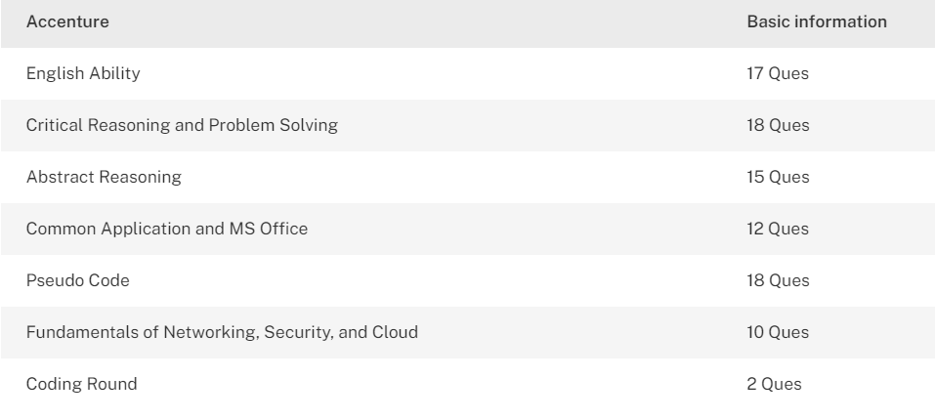

Accenture Exam Syllabus for Freshers

Slide 3
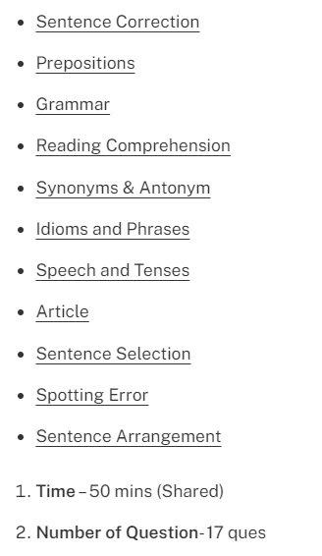

Detailed Syllabus of Verbal Ability

Slide 4
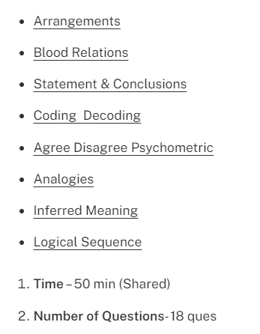

Detailed Syllabus of Critical Reasoning

Slide 5
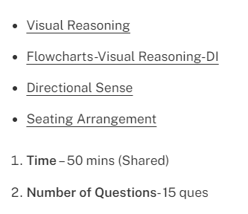

Detailed Syllabus of Abstract Reasoning

Slide 6
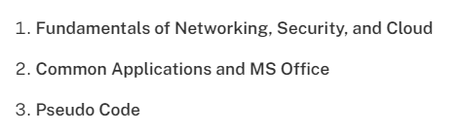

Technical Section

Slide 7
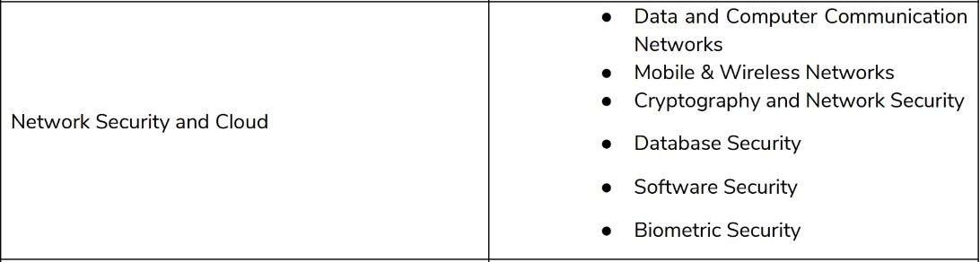



Slide 8

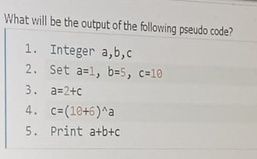
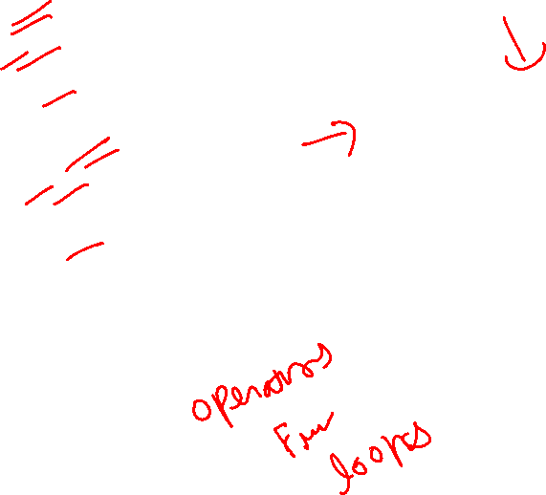

Slide 9
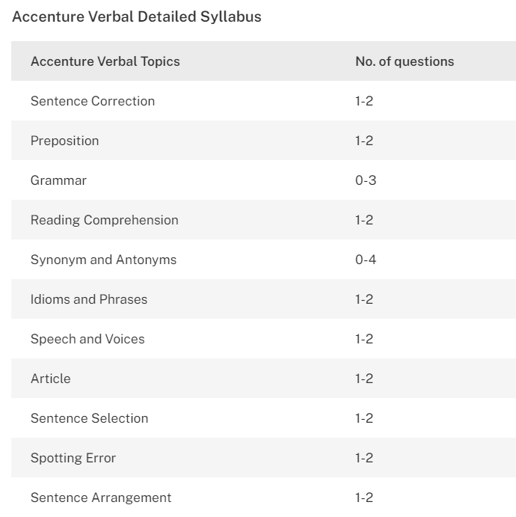
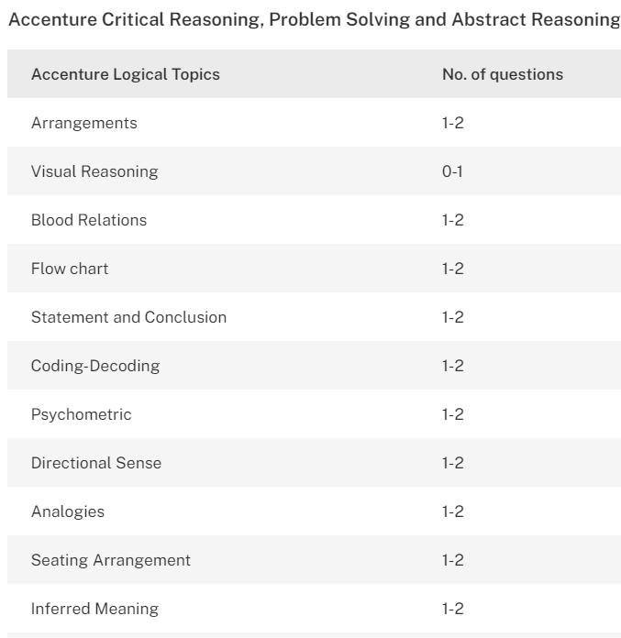


Slide 10
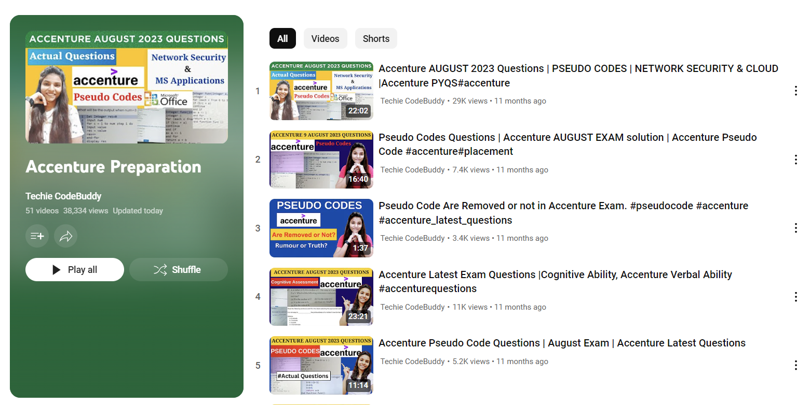

Where to Prepare ?

Slide 11
